Slide 1
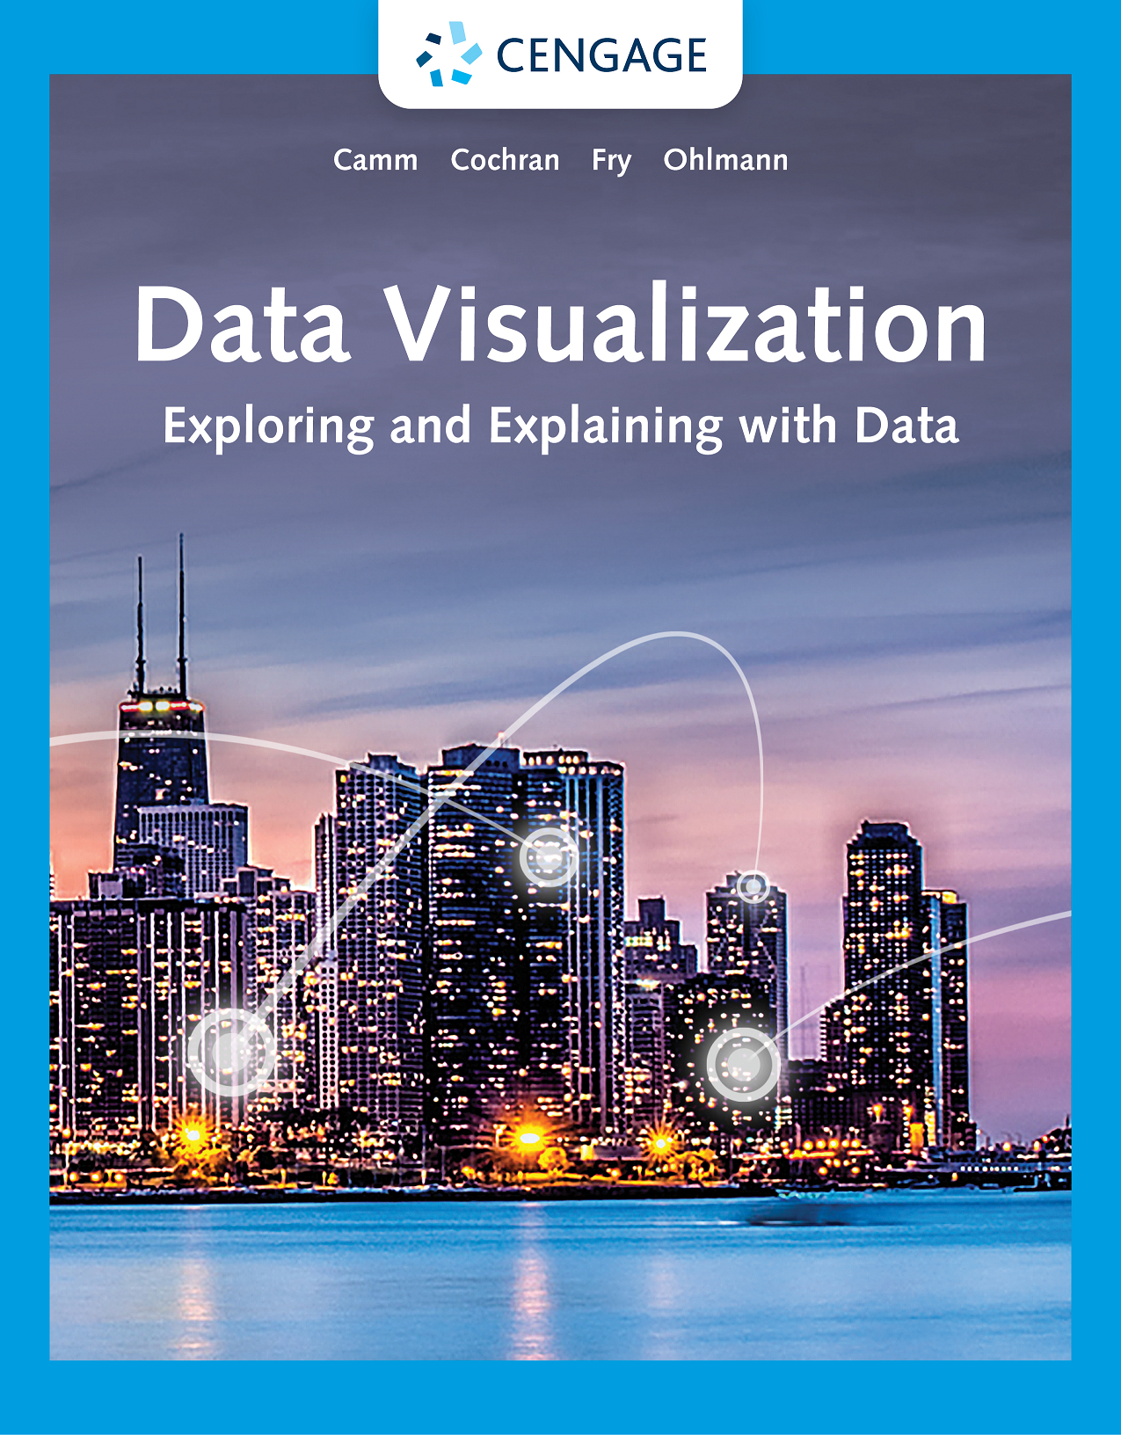
Data Visualization, 1e
Chapter 3: Data Visualization and Design

Slide 2
Chapter Objectives (1 of 2)
After completing this chapter, you will be able to:
LO 3.1a Define preattentive attributes
LO 3.1b Explain how preattentive attributes associated with color, form, spatial positioning, and movement are used in data visualizations
LO 3.2 Explain how the Gestalt principles of similarity, proximity, enclosure, and connection can be used to create effective data visualizations
LO 3.3a Define data-ink ratio

Slide 3
Chapter Objectives (2 of 2)
LO 3.3b Explain how increasing the data-ink ratio through decluttering can create data visualizations that are easier to interpret
LO 3.4 Create data visualizations that are easier to interpret by minimizing the required eye travel and applying the concepts of preattentive attributes, Gestalt principles, and decluttering
LO 3.5 Explain why certain types of font are preferred over others for use of text in data visualizations
LO 3.6 List several common mistakes in designing data visualizations and explain how these mistakes can be avoided

Slide 4
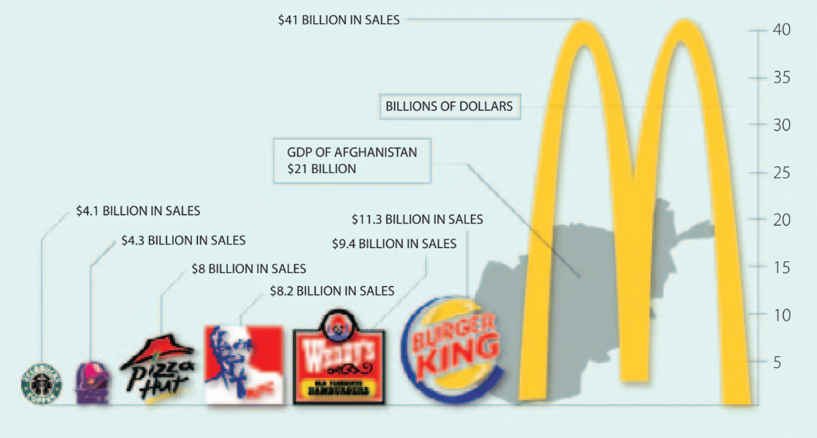
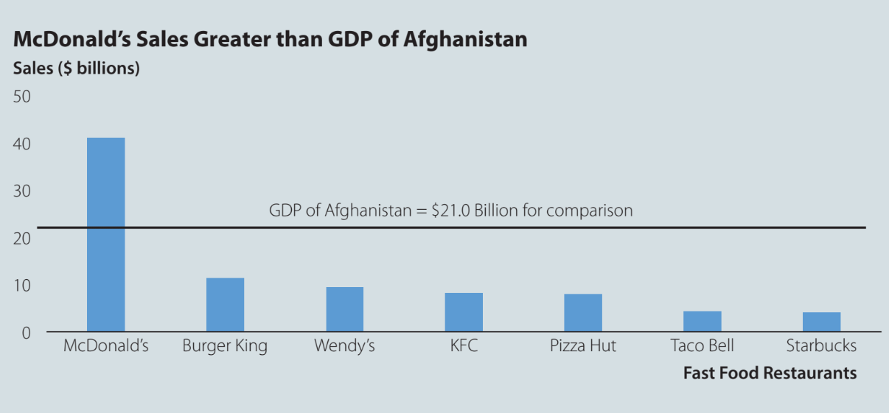
Data Visualization Makeover
Column chart using logos to compare fast-food restaurant sales
Improved column chart to compare fast-food restaurant sales
(Source: http://www.princeton.edu/~ina/infographics/starbucks.html)
*See additional comments in the notes.
Notes:
Using graphics and logos can make charts more visually appealing, but not when it comes to distracting the audience or making it difficult to interpret the chart.
It is natural to compare the sales values based on the logo’s overall area. However, each logo’s height defines the company’s sales, as the width of each logo is not used to convey any meaningful information.
Consider the shape of the country of Afghanistan, which is also hidden behind the McDonald and Burger King’s logos, making the chart excessively cluttered.
Finally, displaying the vertical axis on the right of the chart makes the chart difficult to interpret, as it requires the audience to move their eyes back and forth.
It is better to remove the meaningless dimension of the width of the logo in the chart and use the column chart to the right instead. The column chart also has the vertical axis displayed to the left, and the horizontal line across the chart accomplishes the comparison to the country of Afghanistan.

Slide 5
3.1 Visual Perception and Preattentive Attributes
Visual perception is the brain process that interprets the reflections of the light entering our eyes.
Three forms of memory affect visual perception:
Iconic memory holds information for less than a second, and it is processed automatically.
Short-term memory is grouped in chunks of information and holds information for about a minute.
Long-term memory holds information for more extended periods through repetition, rehearsal, or story-telling.
Preattentive attributes are features processed by iconic memory.

Slide 6
3.1 Cognitive Load and Preattentive Attributes
Cognitive load is the effort needed to accurately and efficiently process information communicated by a data visualization.
Proper use of preattentive attributes reduces the cognitive load in a data visualization.
The four preattentive attributes related to visual perception are:
Color
Form
Spatial positioning
Movement

Slide 7
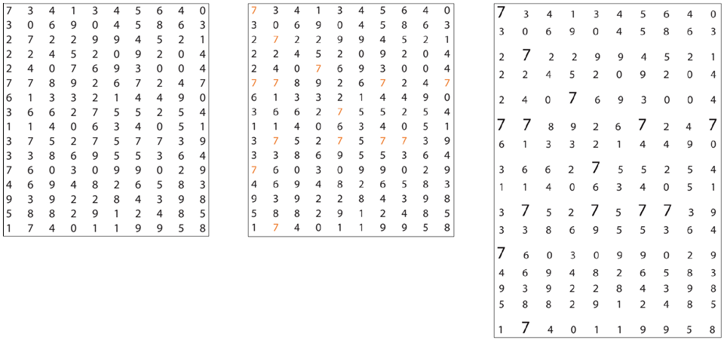
3.1 Application of Preattentive Attributes
Count the number of 7s aided by the preattentive attributes of color and form (size)

Slide 8
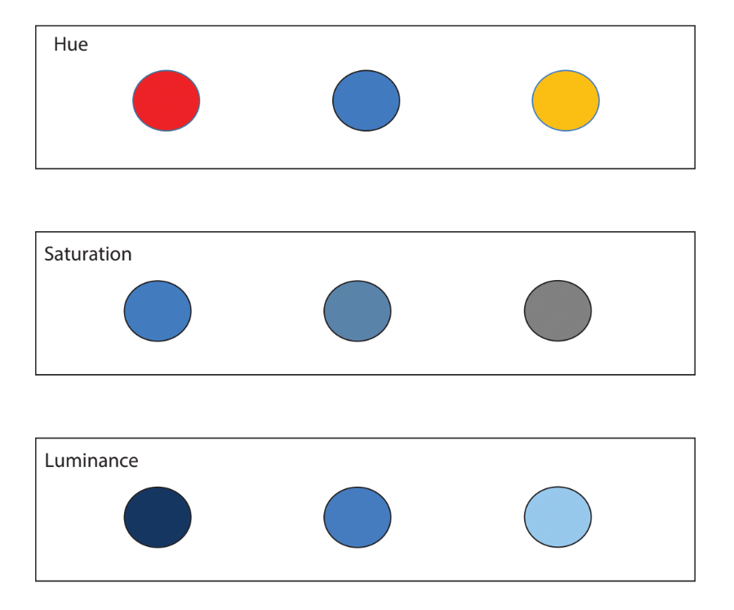
3.1 The Preattentive Attribute of Color
The preattentive attribute of color includes hue, saturation, and luminance
Hue is the position light occupies on the visible light spectrum. It is the basis of the different colors.
Saturation is the amount of gray present in color. It refers to the intensity or purity of the color.
Luminance refers to the amount of black versus white within the color.

Slide 9
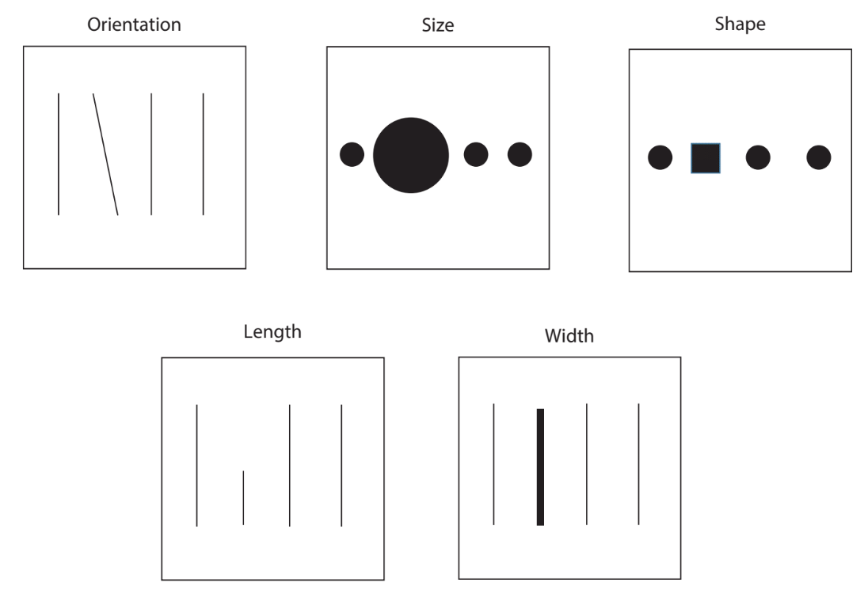
3.1 The Preattentive Attributes of Form
The preattentive attributes of form include orientation, size, shape, length, and width
Orientation refers to the relative positioning of an object within a data visualization. It is common in line graphs.
Size refers to the relative amount of space an object occupies in a visualization. Most people struggle to estimate relative size differences.
Shape refers to the form of objects used in data visualization to distinguish between groups.
Length and Width refer to the distance and thickness of a line or bar/column, respectively.

Slide 10
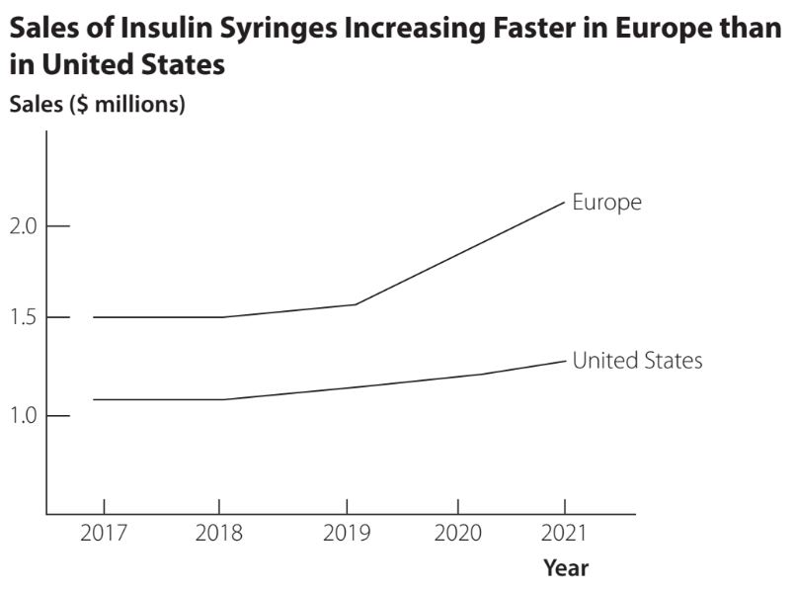
3.1 The Preattentive Attribute of Orientation
Demonstration of the preattentive attribute of orientation
The difference in the orientation of these lines makes it easy for the audience to perceive that sales in Europe are increasing at a much faster rate than the United States for the years 2019 and 2020.

Slide 11

3.1 The Preattentive Attribute of Size
Demonstration of the preattentive attribute of size
The heights and widths of both the bigger square and bigger circle are three times larger than their smaller counterparts, but their respective areas are nine times bigger.
Most people are not good at estimating relative size differences using the attribute of size.

Slide 12
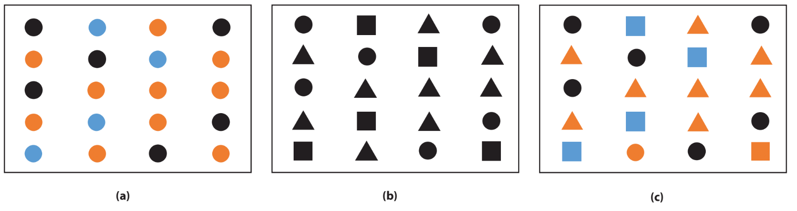
3.1 The Preattentive Attribute of Shape
Grouping items by color and shape
The preattentive attribute of color divides the items into three different groups: orange, blue, and black.
The preattentive attribute of shape divides the items into three groups: circle, square, and triangle.
The combination of preattentive attributes of color and shape divides the items into nine groups, each with one of the three colors combined with one of the three shapes

Slide 13
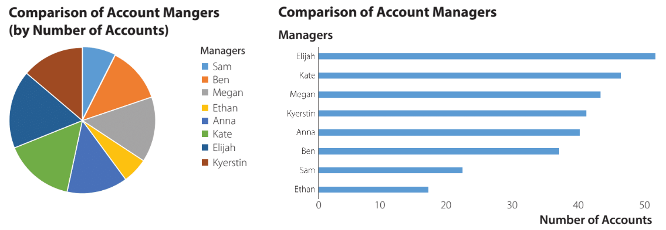
3.1 The Preattentive Attribute of Length
The bar chart (preattribute of length) makes it easier to display the accounts managed data than the pie chart (preattributes of size and color)
Line, bar, and column charts often employ the preattentive attributes of length and width:
The Length refers to the horizontal, vertical, or diagonal distance of a line or bar/column.
The Width refers to the thickness of the line or bar/column.

Slide 14
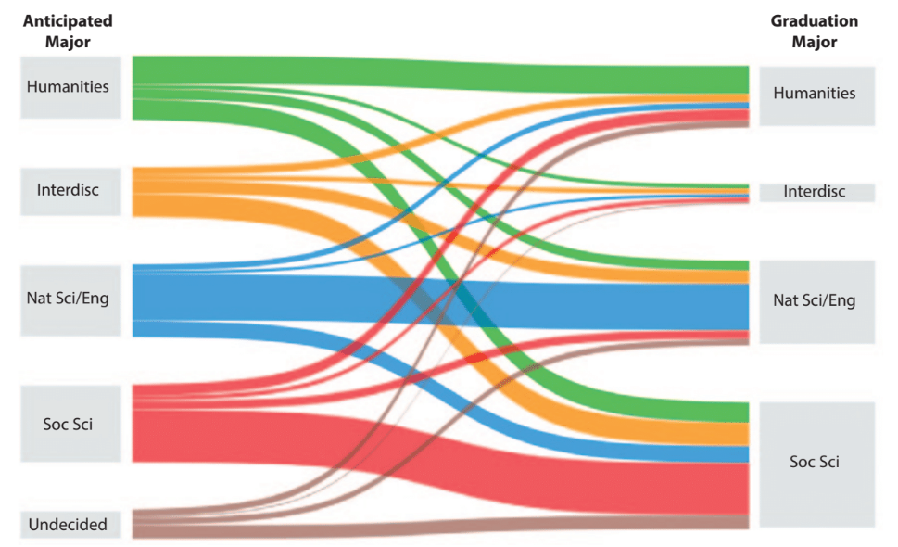
3.1 The Preattentive Attribute of Width
A Sankey chart demonstrating the use of the line width attribute
A Sankey chart typically depicts the proportional flow of entities where the width of the line represents the relative flow rate compared to the widths of the other lines.
In the example shown, the graduation major for students in a liberal arts college flows from the anticipated major.
The line width attribute is used much less frequently in data visualizations.

Slide 15
3.1 The Attributes of Spatial Positioning and Movement
Spatial positioning refers to the location of an object within some defined space.
The most used spatial positioning in tables and charts is 2-D, such as the data points in a scatter chart.
Movement can be categorized into two main attributes:
Flicker refers to effects such as flashing to draw attention.
Motion involves directed movement and can be used to show changes within a visualization.
Movement is not possible in most data visualizations because tables and charts are static.

Slide 16
3.2 Gestalt Principles
Gestalt principles refer to the guiding principles of how people interpret and perceive what they see.
These principles generally describe how people define order and meaning in the things they see.
The four main Gestalt principles related to the design of data visualizations are:
Similarity
Proximity
Enclosure
Connection

Slide 17
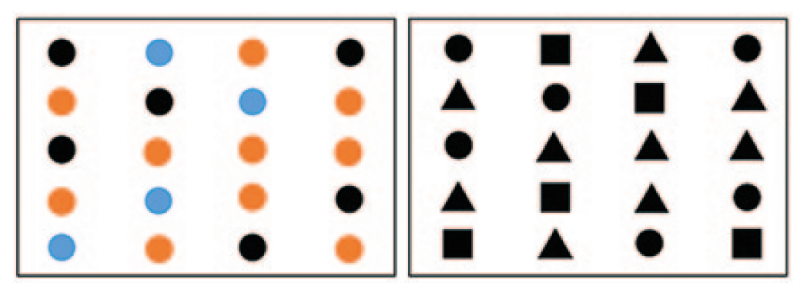
3.2 Gestalt Principle of Similarity
People consider objects with similar characteristics as belonging to the same group
The audience will perceive objects of the same color, or the same shape, as belonging to the same group.

Slide 18
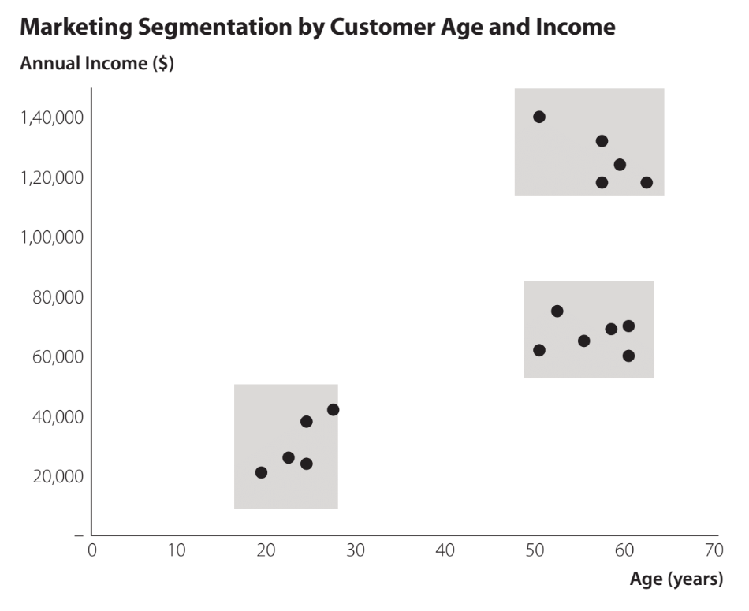
3.2 Gestalt Principle of Proximity
People consider objects physically close to one another as belonging to the same group
People will seek to group objects near each into the same group and objects that are far from one another into different groups.

Slide 19
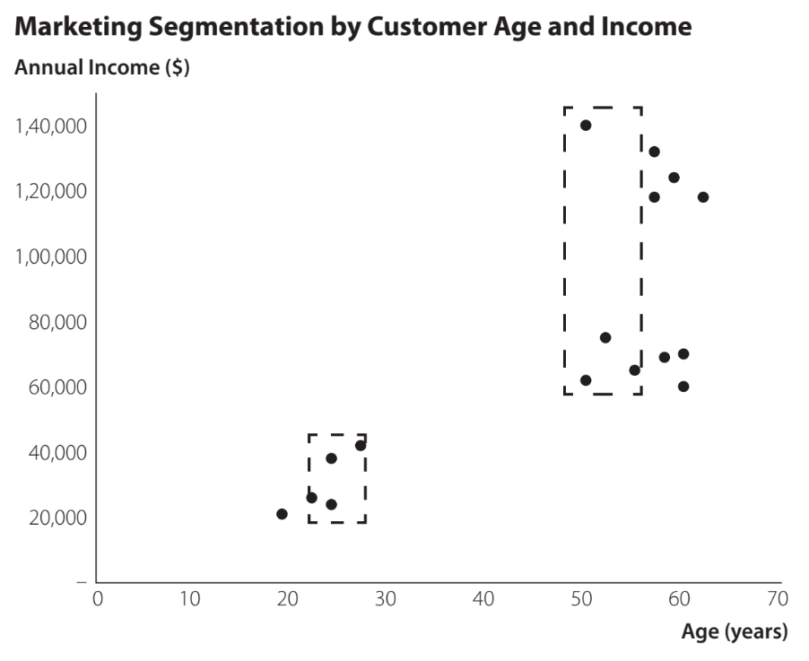
3.2 Gestalt Principle of Enclosure
People consider objects physically enclosed together as belonging to the same group
The presence of a third attribute besides age and income, such as educational background, can be visually indicated with enclosures.

Slide 20
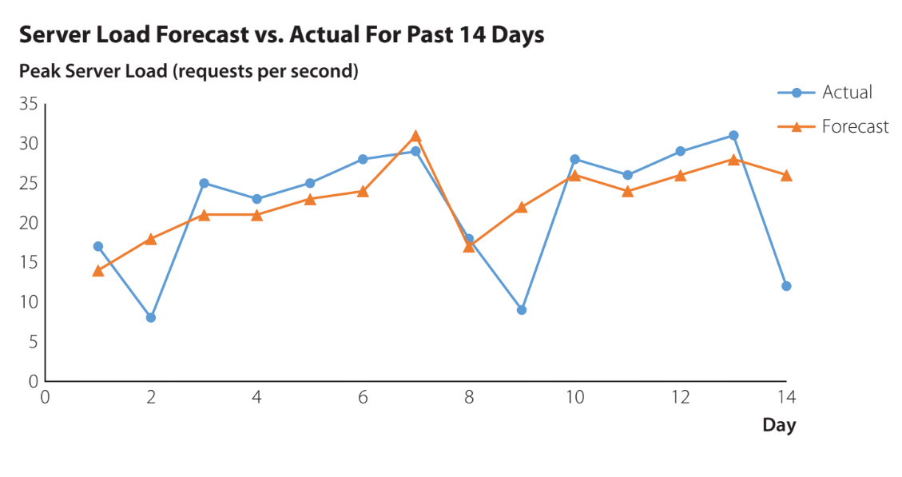
3.2 Gestalt Principle of Connection
People interpret connected objects as belonging to the same group
The principle of connection in data visualization is often used for time-series data.
Connecting the markers emphasizes trends and makes it easier to separate forecast values from actual values.

Slide 21
3.3 Data-Ink Ratio
Data-ink ratio is the proportion of ink used for data to the total amount of ink in a table or chart.
Helpful for creating effective tables and charts for data visualization
Data-ink: ink used in a table or chart that is necessary to convey the meaning of the data to the audience
Non-data-ink: ink used in a table or chart that serves no useful purpose in conveying the data to the audience
Decluttering is the process of increasing the data-ink ratio in a chart

Slide 22
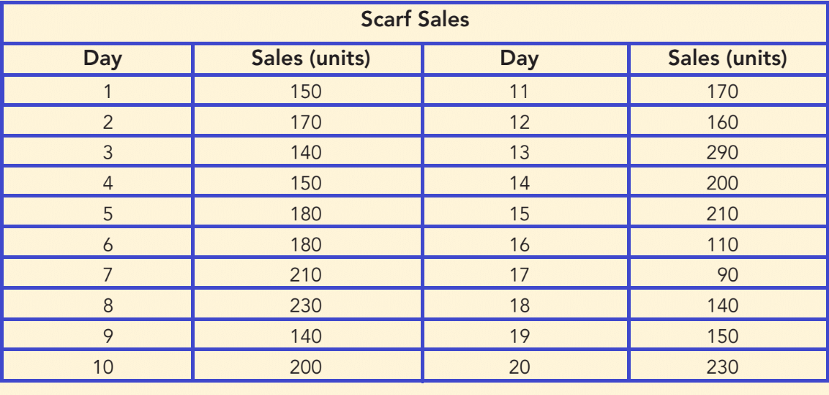
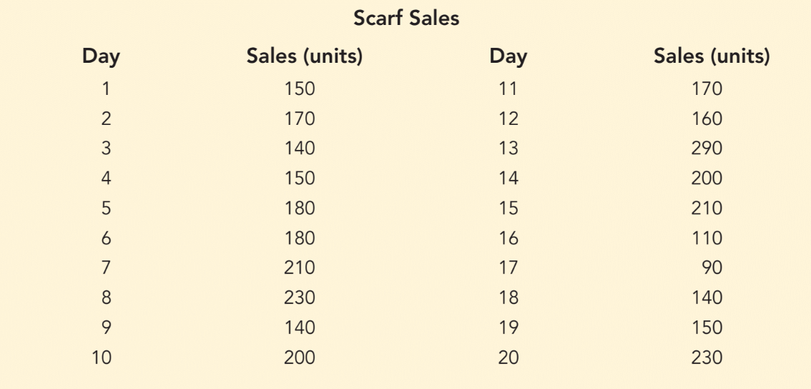
3.3 Data-Ink Ratio in Tables (1 of 2)
Example of low data-ink table
Example of high data-ink table
White space is the portion of a data visualization that is devoid of markings. Its use is equivalent to increasing the data-ink in a visualization.
*See notes for step-by-step instructions on how to increase data-ink for this example.

Slide 23
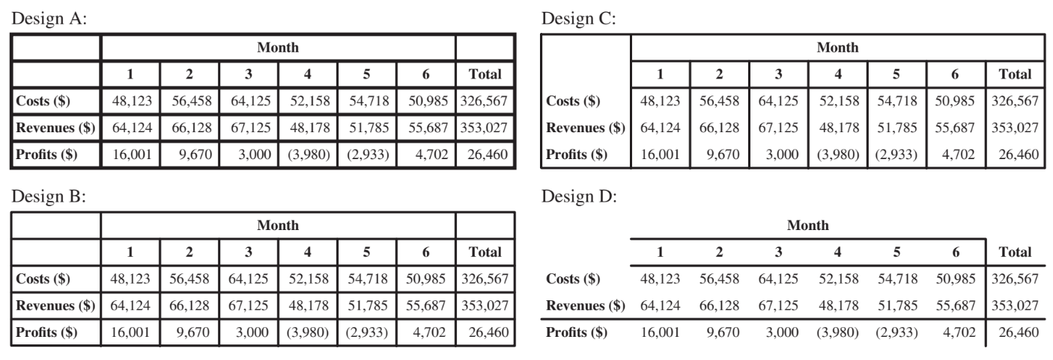
3.3 Different Levels of Data-Ink Ratio in Tables
Comparing different table designs with different data-ink ratios

Slide 24
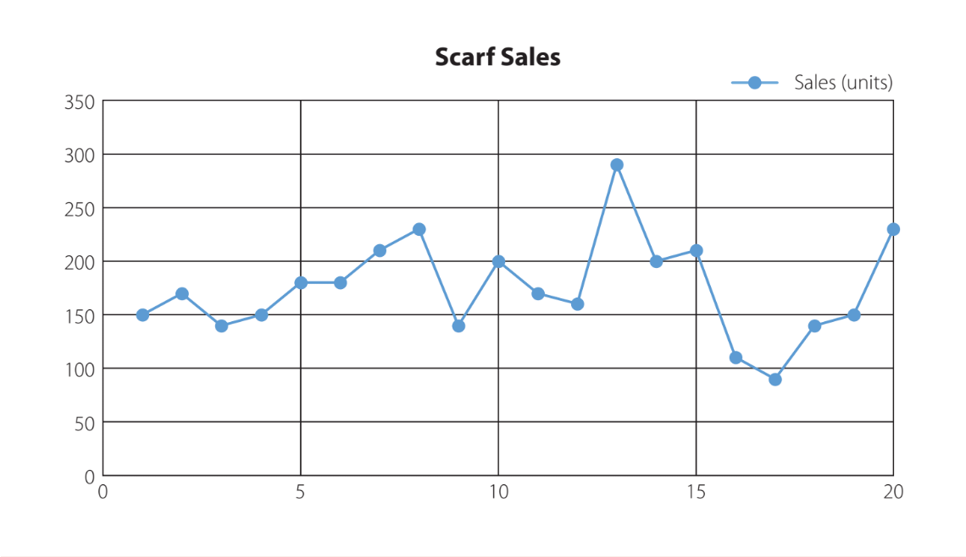
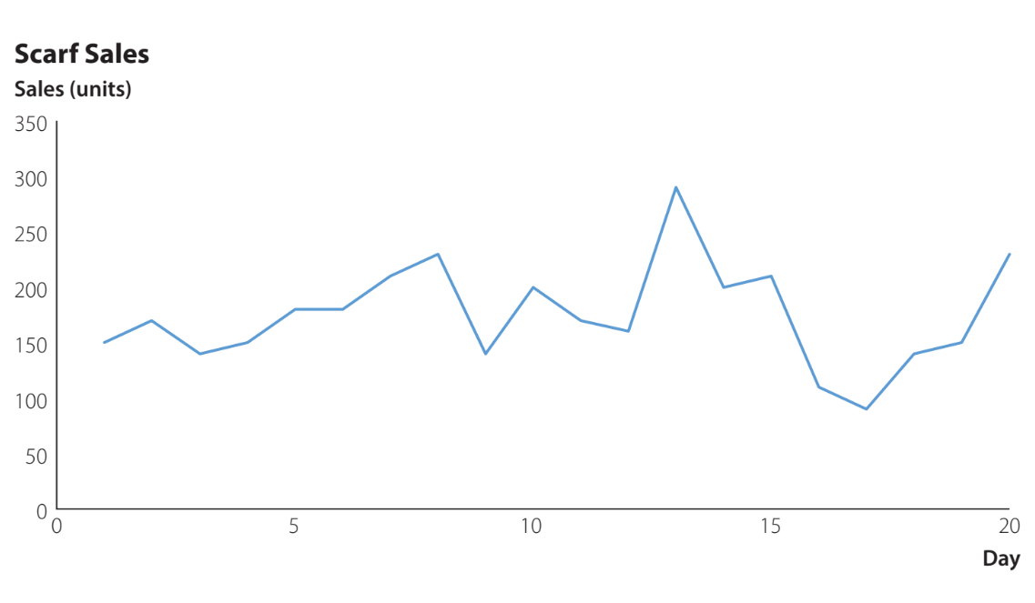
3.3 Increase Data-Ink Ratio in Charts to Increase Clarity
Example of low data-ink chart
Example of high data-ink chart
Notes:
Step1. Start with the chart in the file ScarfSalesChart
Click anywhere on the chart
Click the Chart Elements button
Deselect the check box for Gridlines
Deselect the check box for Legend
Step 2. Double-click one of the data points in the chart
When the Format Data Series task pane appears, click the Fill & Line icon
Select Marker and under
Marker Options select None
Step 3. Click the chart title “Scarf Sales”
Drag this text box to the left so that it aligns with the vertical axis
Click the Home tab on the Ribbon and select the Align Left button in the Alignment group to left justify the chart title
Click the chart title text box, type Sales (units) under the existing chart title, and change the font of this text to Calibri 10.5 Bold to create the vertical axis title
Step 4. Click the Insert tab on the Ribbon and select Text Box from the Text group
Click on the chart just below the end of the horizontal axis to create a title for this axis
Type Day into the text box and position it just below the end of the horizontal axis
Change the font for this text to Calibri 10.5 Bold to create the horizontal axis title

Slide 25
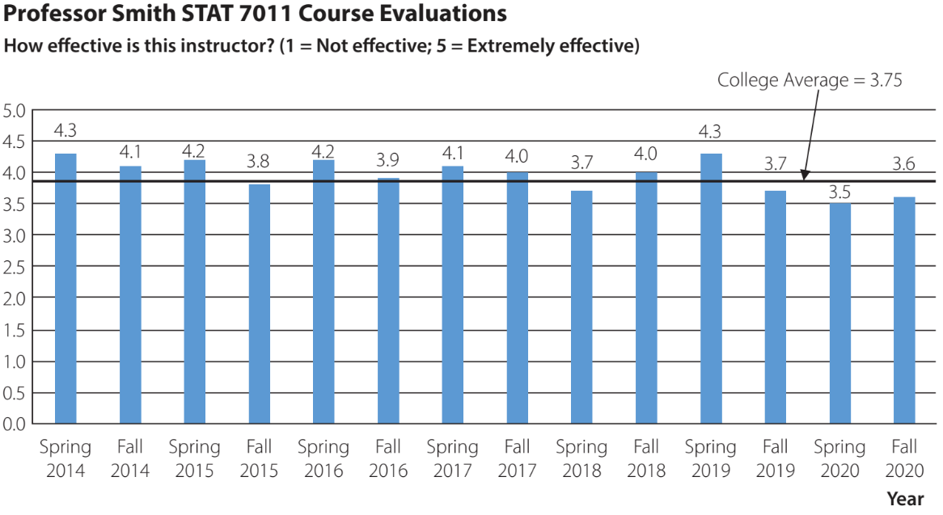
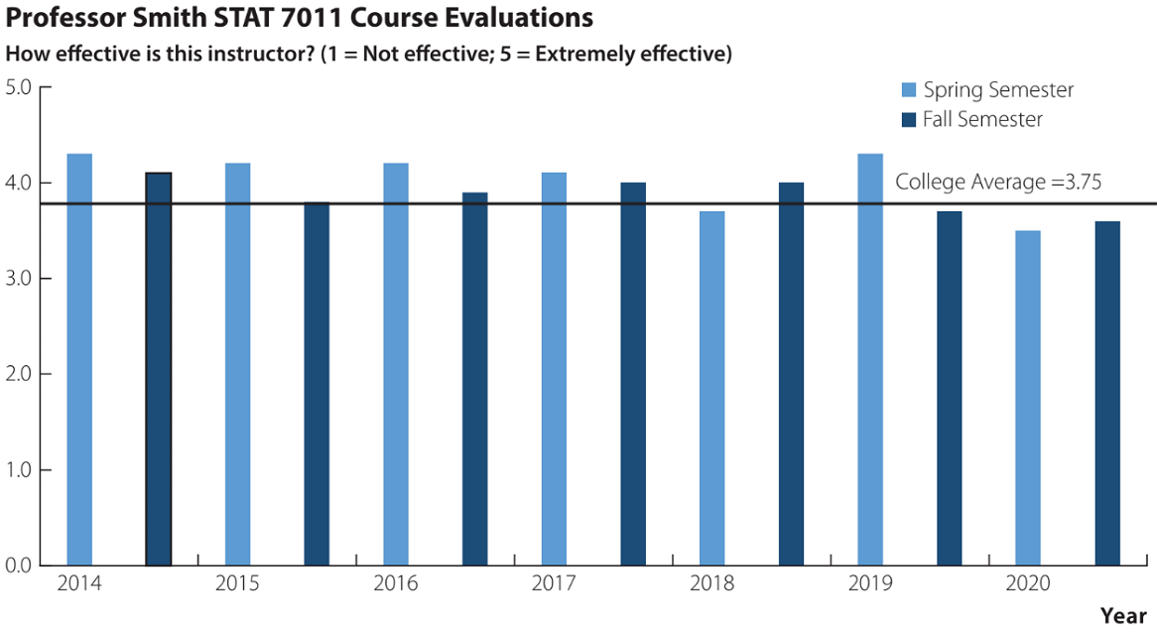
3.3 Increase Data-Ink Ratio in Charts to Decrease Clutter
A cluttered column chart for the STAT 7011 course evaluation data
An improved column chart for the STAT 7011 course evaluation data
*See step-by-step instructions on how to improve cluttering for this example in the notes.
Notes:
Step 1. Start with the chart in the file CourseEvalsChart
Click anywhere on the chart
Click the Chart Elements button
Deselect the check box for Gridlines
Deselect the check box for Data Labels
Step 2. Click anywhere on the chart
Select the vertical axis
Step 3. When the Format Axis task pane appears
Change the entry in the Major Box under Units from 0.5 to 1.0 to remove the vertical-axis increments of 0.5
Step 4. Double-click the second column in the chart corresponding to “Fall 2014” so that only this column is selected in the chart
In the Format Data Point task pane, click the Fill & Line icon
Under Fill, select a darker blue color for this column
Step 5. Repeat Step 4 for each column corresponding to a Fall semester in the chart
Step 6. Click the semester labels below the horizontal axis and press Delete to remove the name of each column
Step 7. Delete the text in cells A2:A15 to remove the horizontal axis labels.
Type 2014 in cell A2, 2015 in cell A4, 2016 in cell A6, 2017 in cell A8, 2018 in cell A10, 2019 in cell A12 and 2020 in cell A14 to add the years to the horizontal axis on the chart.
Step 8. Click the arrow in the chart pointing to the line for the college average evaluation score and press Delete
Step 9. Move the text box containing College Average = 3.75 closer to the line that marks the college average evaluation score
Step 10. Click the Insert tab on the Ribbon
Click Text Box in the Text group and click near the upper right of the chart
Click the Home tab in the Ribbon and change the font type to Wingdings 10.5
Type n in the text box to create a square box
Change the font color of the square box to match the lighter blue columns in the chart
Change the font type back to Calibri 10.5 and the font color back to black
Type Spring Semester and press Enter
Click the Home tab in the Ribbon and change the font type to Wingdings 10.5
Type n in the text box to create a square box
Change the font color of the square box to match the darker blue columns in the chart
Change the font type back to Calibri 10.5 and the font color back to black
Type Fall Semester
Step 11. Line up any added elements of the chart that may have been moved in the editing process.

Slide 26
3.3 Suggestions for Text Alignment in Tables
Columns of numerical values in a table should usually be right-aligned.
All columns showing values should include the same number of decimal digits.
Only include the necessary number of decimal digits. Additional digits that are not meaningful to the audience increase clutter.
For extremely large numbers, display data rounded to the nearest thousand, ten thousand, or million.
It is generally most effective to left-align text values within a column in a table.

Slide 27
3.4 Minimizing Eye Travel
We can minimize the cognitive load needed to view and interpret data visualization by:
using preattentive attributes
using Gestalt principles
increasing the data-ink ratio
minimizing eye travel
*See additional comments in the notes.
Notes:
The chart design steps we illustrate in this section require extra work. Whether this extra work is necessary depends on the intended use and audience for the chart. If the chart is for simply exploring data or for use as a draft to generate feedback, it is less important to format all elements; reformats such as changing axes label locations and changing font sizes of text are not necessary at that point.
However, for final versions of charts presented to an external audience, it is often worth spending extra time to make the chart as easy as possible for the audience to interpret

Slide 28
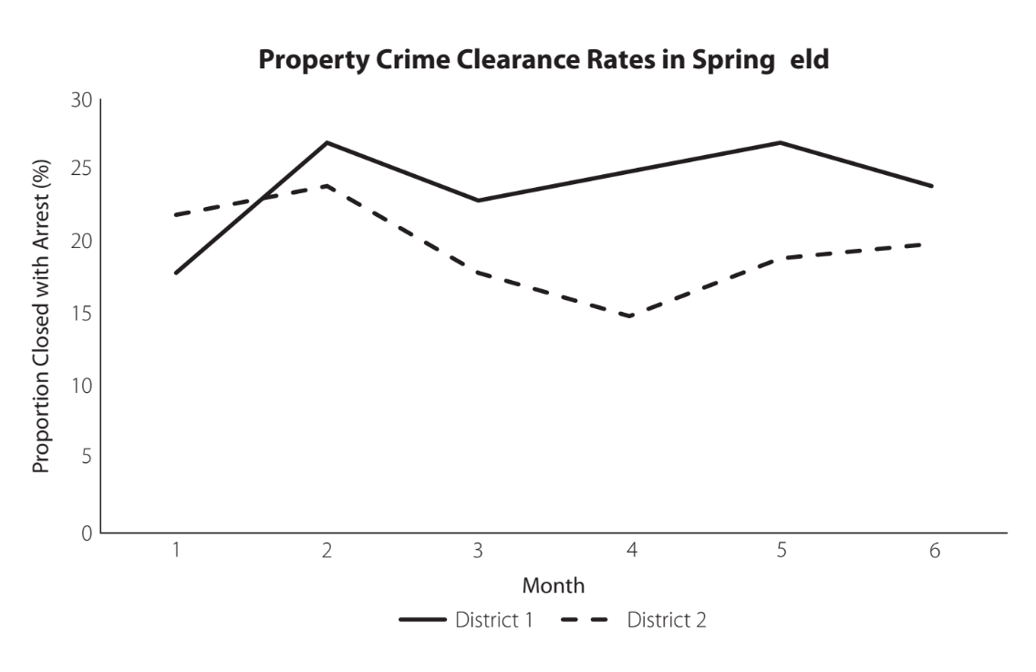
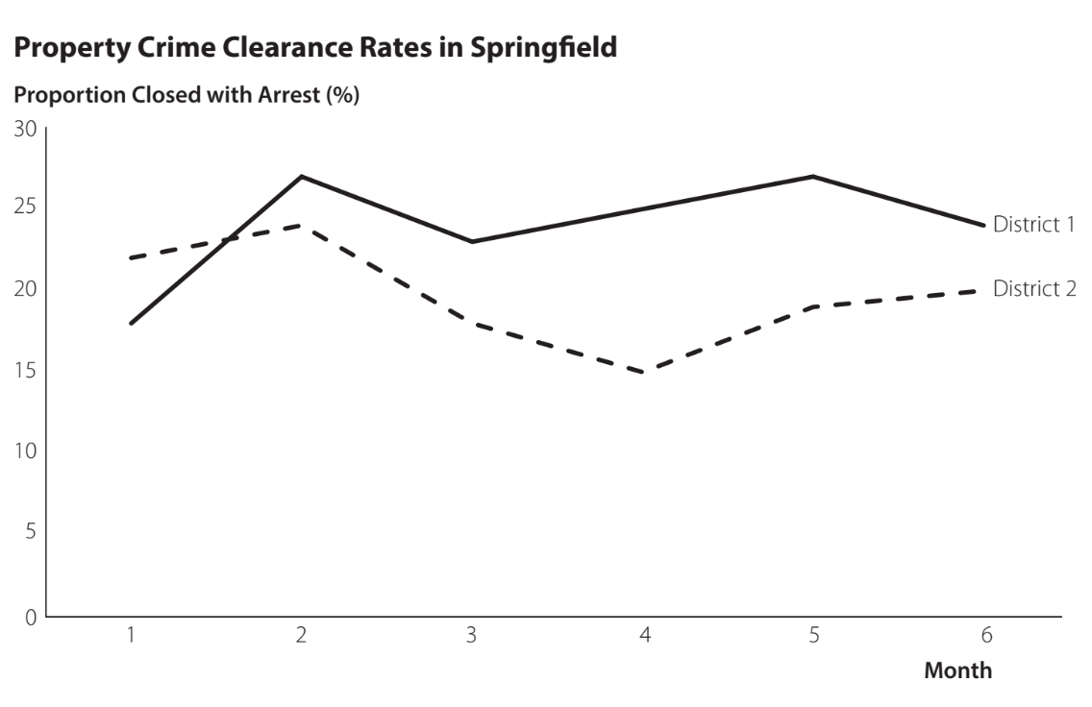
3.4 Minimizing Eye Travel in a Chart
A default line chart created in Excel for property crime clearance rates
Improved line chart for property crime clearance rates – Minimized eye travel
Required eye travel is minimized by:
Aligning the chart title and vertical-axis title with the vertical axis
Moving the line labels adjacent and to the right of the chart lines
Aligning the horizontal-axis label with the line labels at the end of the horizontal axis.
*See step-by-step instructions on how to improve the line chart in the notes.
Notes:
When to include axes titles and chart titles is often a matter of opinion. We recommend having a chart title when it is necessary for clarification or to make explicit the intended message of the chart. However, we recommend omitting chart and axes titles when they only provide redundant information.
Step 1. Start with the chart in the file ClearanceRatesChart
Click anywhere on the chart
Click the Chart Elements button
Deselect the check box for Legend
Step 2. Double-click the last data point on the line in the chart for the District 1 data to select only that data point
Right-click the selected data point and select Add Data Label (this will add a data label with the value of this data point which is “24”)
Change the “24” in this data label to District 1 and change the font to Calibri 10.5
Step 3. Double-click the last data point on the line in the chart for the District 2 data to select only that data point
Right-click the selected data point and select Add Data Label (this will add a data label with the value of this data point, which is “20”)
Change the “20” in this data label to District 2 and change the font to Calibri 10.5
Step 4. Click the vertical-axis title “Proportion Closed with Arrest (%)”
Click Delete
Step 5. Click the chart title “Property Crime Clearance Rates in Springfield”
Drag this text box to the left so that it aligns with the vertical axis
Click the Home tab on the Ribbon and select the Align Left button in the Alignment group to left justify the chart title
Step 6. Click the Insert tab on the Ribbon
Click Text Box in the Text group and click above the vertical axis to create a text box for the vertical axis title
Type Proportion Closed with Arrest (%) in the text box and change the font to Calibri 10.5 Bold to create the vertical axis title
Step 7. Click the horizontal-axis title “Month” and drag the text box to the end of the horizontal axis so that it lines up with the last label on the horizontal axis, in this case the “6”

Slide 29
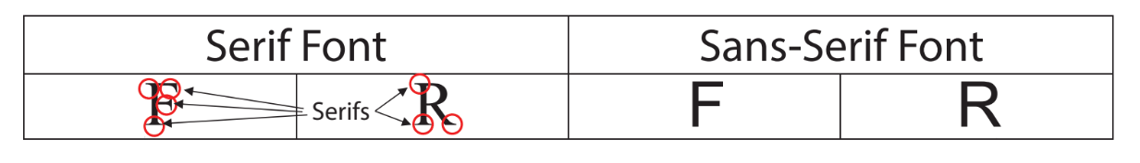
3.4 Choosing a Font for Text
Serif Font
Preferred for text in printed work
Includes end-of-stroke features
Less legible at small sizes
Common fonts include:
Times, Times New Roman, and Courier
Sans-Serif Font
Preferred for text in data visualization
Does not Includes end-of-stroke features
More legible at small sizes
Common fonts include:
Arial, Calibri, Myriad Pro, and Verdana

Slide 30
3.4 Suggestions for Choice of Font for Text
The choice of the font in data visualization should be consistent and restrained.
Most data visualizations should use a single type of font for text to minimize cognitive load.
Horizontal- and vertical-axis titles should have the same font type and size.
The use of different font sizes, bold, italic, and color enhancements, help differentiate between features and direct audience attention.

Slide 31
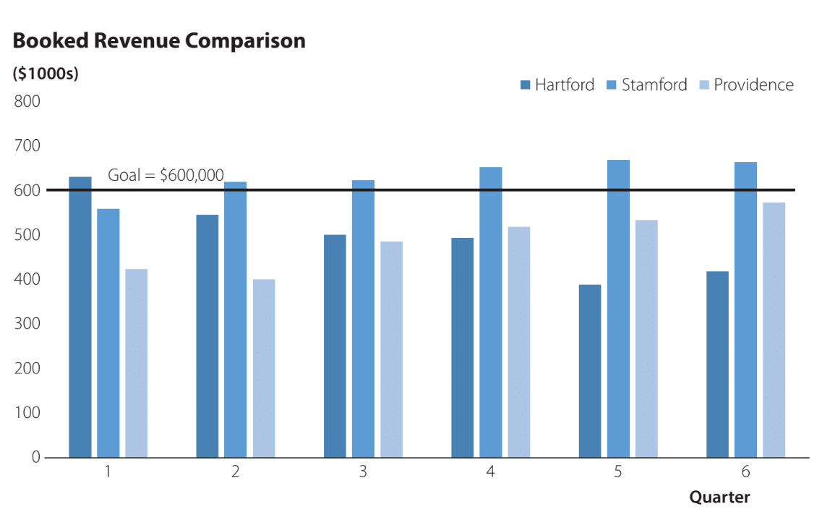
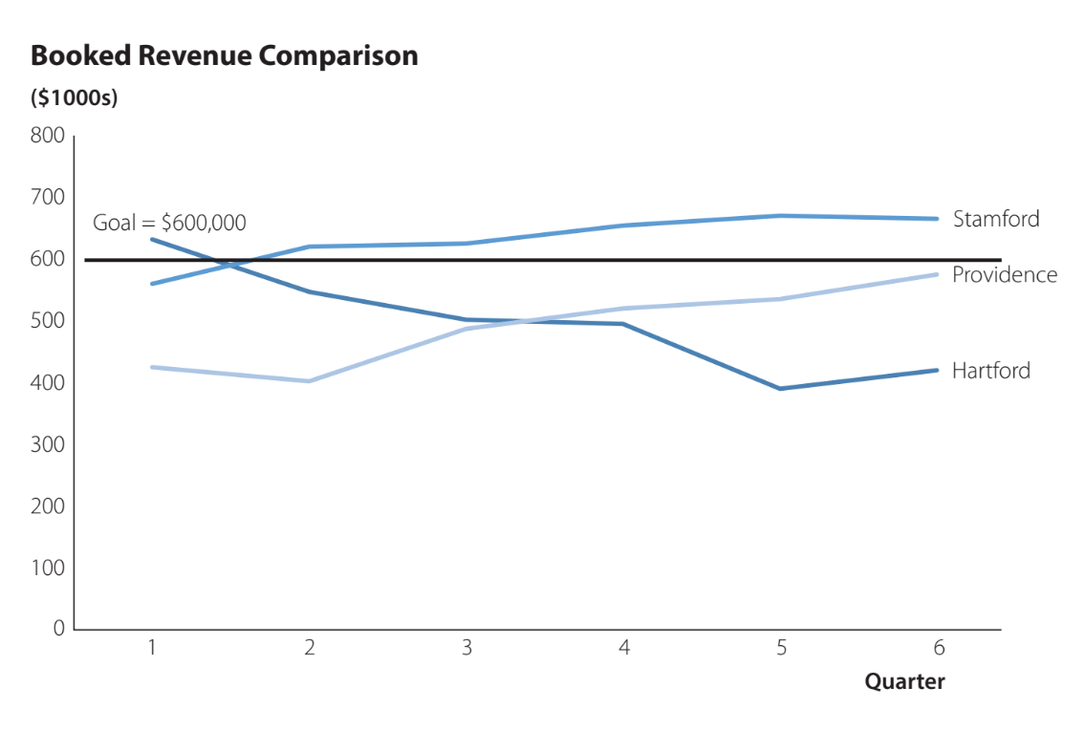
3.5 The Wrong Type of Visualization
A cluttered clustered column chart for the booked revenue data comparison
An improved line chart for the booked revenue data comparison
*See step-by-step instructions on how to improve the chart in the notes.
Notes:
Step 1. Start with the chart in the file BookedRevenueChart
Right-click anywhere on the chart
Select Change Chart Type
Step 2. When the Change Chart Type dialog box appears
Select Line
Click OK
Step 3. Click anywhere on the line chart.
Click the Chart Elements button
Deselect the check box for Legend
Step 4. Double-click the last data point on the line in the chart for the Stamford data to select only this data point
Right-click the selected data point and select Add Data Label (this will add a data label with the value of this data point, which is “665”)
Change the “665” in this data label to Stamford and change the font to Calibri 10.5
Step 5. Double-click the last data point on the line in the chart for the Providence data to select only that data point
Right-click the selected data point and select Add Data Label (this will add a data label with the value of this data point, which is “575”)
Change the “575” in this data label to Providence and change the font to Calibri 10.5
Step 6. Double-click the last data point on the line in the chart for the Hartford data to select only that data point
Right-click the selected data point and select Add Data Label (this will add a data label with the value of this data point, which is “420”)
Change the “420” in this data label to Hartford and change the font to Calibri 10.5

Slide 32
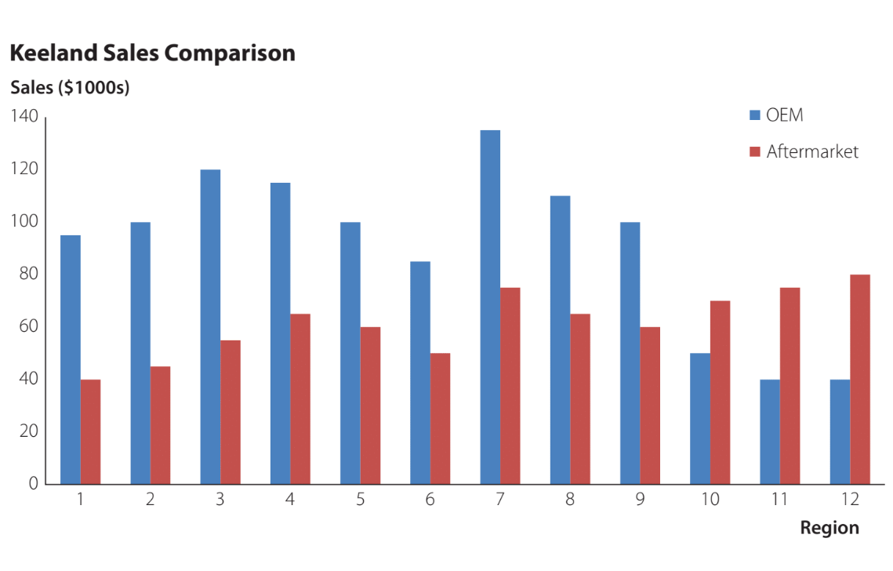
3.5 Displaying Excessive Information
A cluttered clustered column chart showing OEM and aftermarket sales for several regions.

Slide 33
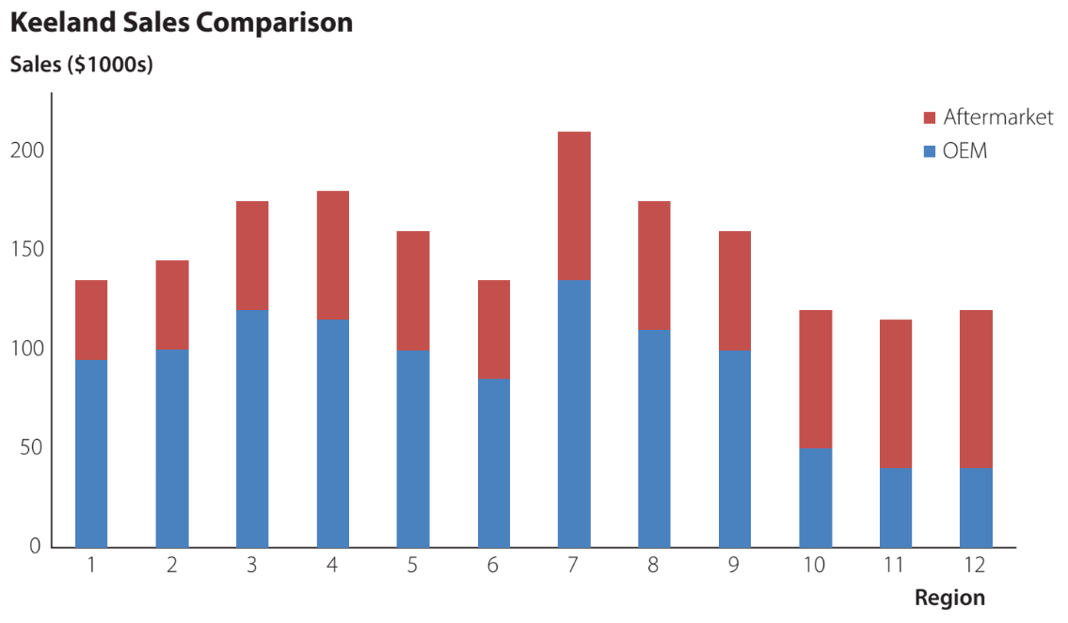
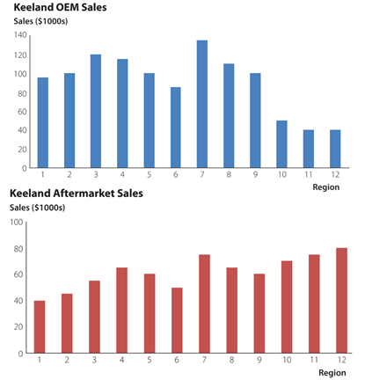
3.5 Displaying Excessive Information – Two Solutions
A stacked clustered column chart showing OEM and aftermarket sales for several regions.
Improved column charts showing OEM and aftermarket sales separately

Slide 34
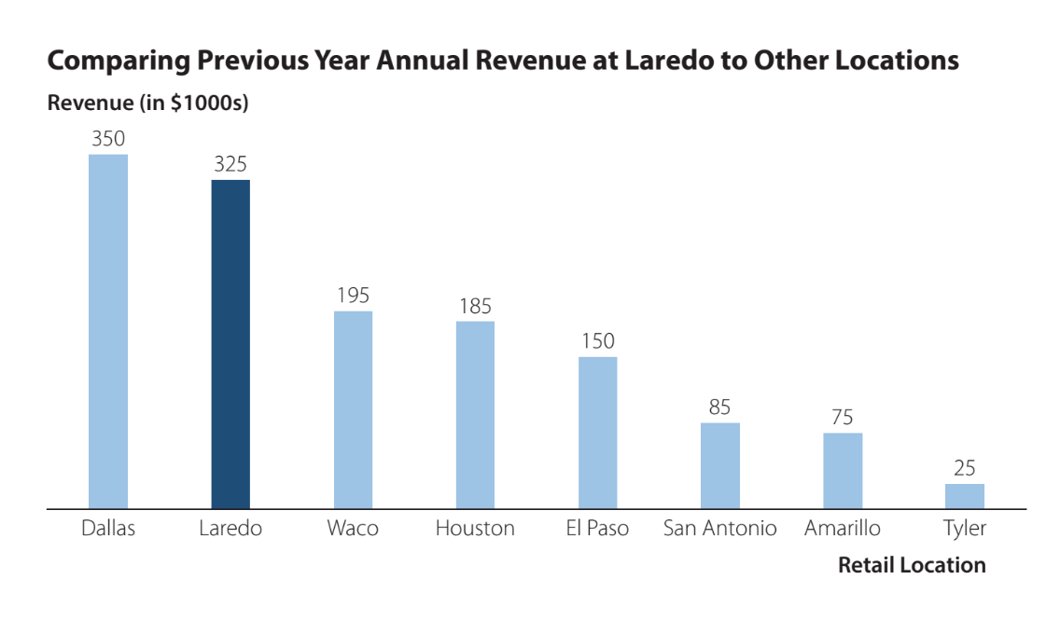
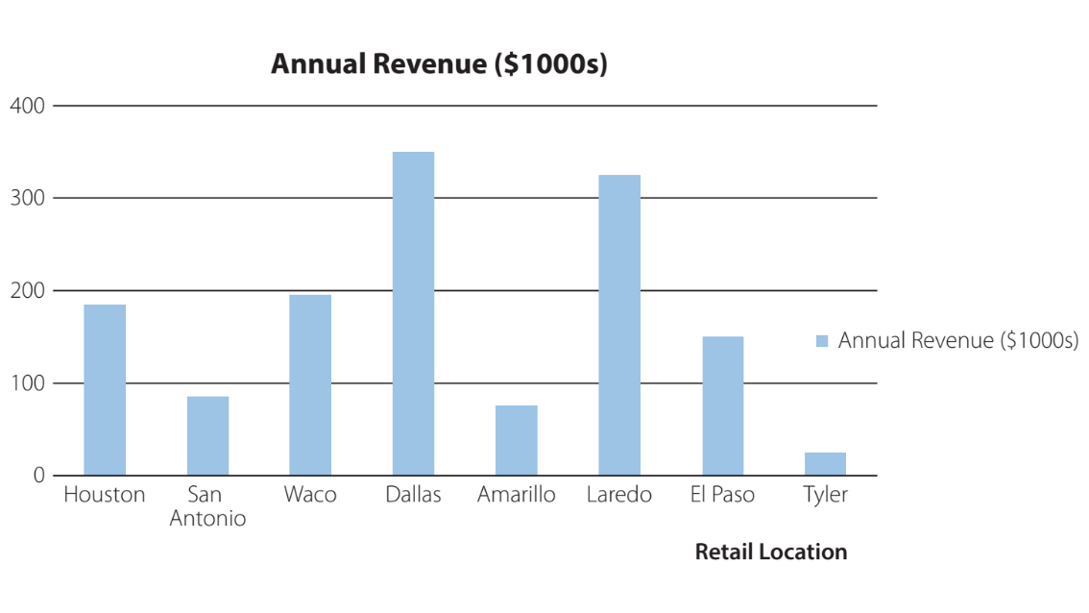
3.5 Using Excel Default Settings for Charts
Default Column Chart Comparing Annual Revenue at Eight Retail Locations
Improved Column Chart Comparing Annual Revenue at Eight Retail Locations
*See step-by-step instructions on how to improve the chart in the notes.
Notes:
Step 1. Start with the chart in the file RetailRevenueChart
Click anywhere on the chart
Step 2. Click the Chart Elements button
Deselect the check box for Gridlines
Deselect the check box for Legend
Step 3. Select cells A1:B9
Click the Data tab on the Ribbon
Click Sort in the Sort & Filter group
Step 4. When the Sort dialog box appears
Select the check box for My data has headers
In the Sort by box select Annual Revenue and in the Order box select Largest to Smallest
Click OK
Step 5. Click the Chart Elements button
Select the check box for Data Labels
Step 6. Click on the vertical axis labels and press Delete
Step 7. Double-click the second column in the chart corresponding to “Laredo” so that only this column is selected in the chart
In the Format Data Point task pane, click the Fill & Line icon
Under Fill, select a darker blue color for this column
Step 8. Click the chart title “Annual Revenue ($1000s)” and change this title to Comparing Previous Year Annual Revenue at Laredo to Other Locations
Drag this text box to the left so that it aligns with the vertical axis
Click the Home tab on the Ribbon and select the Align Left button in the Alignment group to left justify the chart title
Step 9. Click the Insert tab on the Ribbon
Click Text Box in the Text group and click above the vertical axis to create a text box for the vertical axis title
Type Revenue ($1000s) in the text box and change the font to Calibri 10.5 Bold to create the vertical axis title

Slide 35
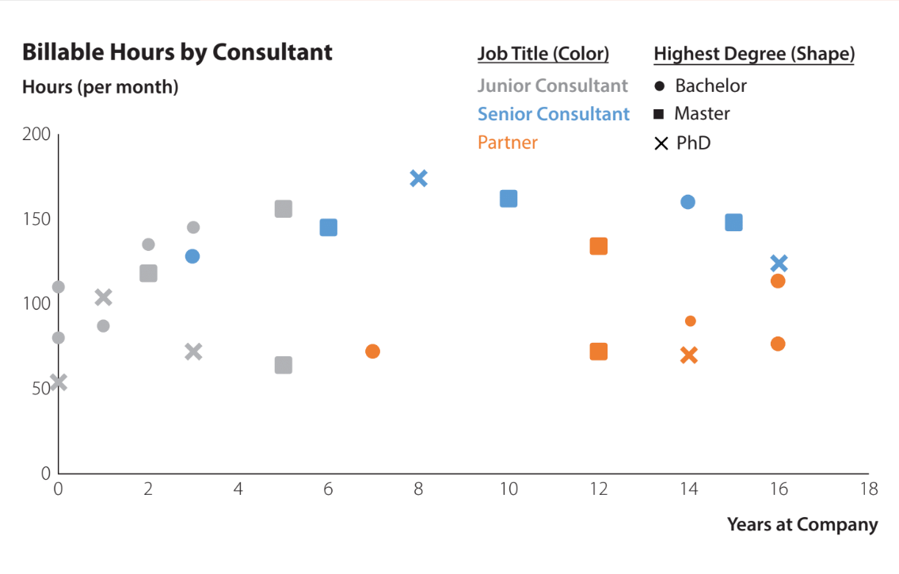
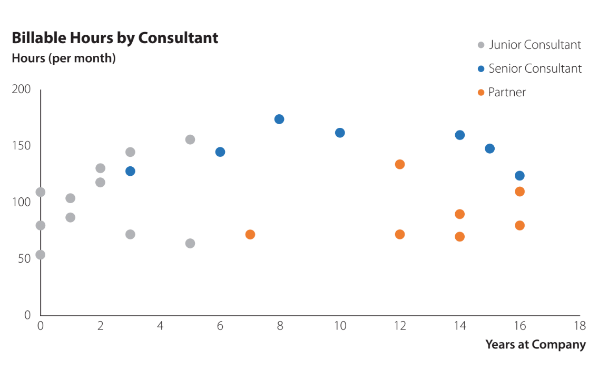
3.5 Too Many Attributes
Chart displaying billable hours association with years at the company, job title, and highest degree attained
Simplified chart displaying billable hours association with years at the company and job title

Slide 36
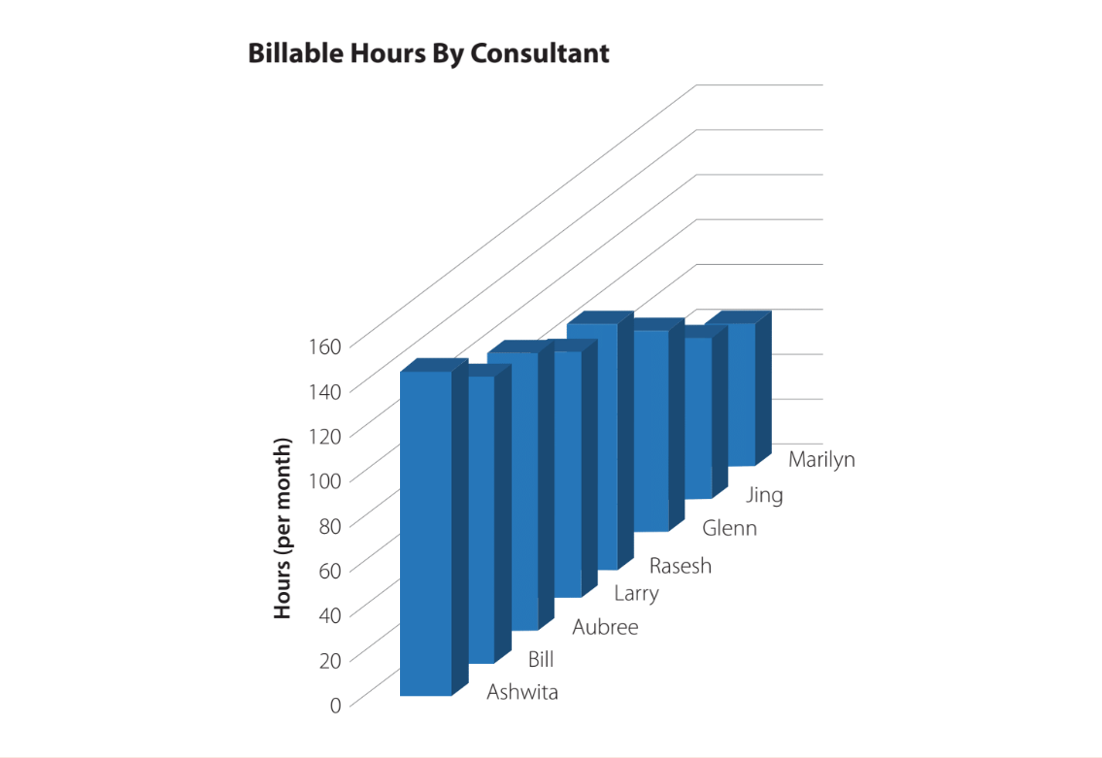
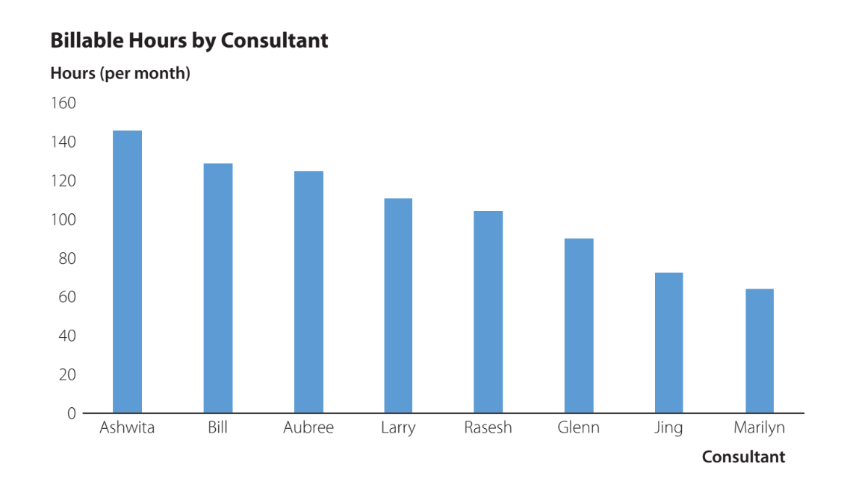
3.5 Unnecessary Use of 3D
A 3D column chart displaying billable hours – the third dimension is not useful
An improved 2D column chart displaying billable hours

Slide 37
Discussion Activity 1
Consider the matrix of 160 single digits (16 rows x 10 columns) shown in the left image of slide 6. The textbook describes how we can aid in counting the number of 7s in the matrix using the preattentive attributes of red hue (middle image of slide 6) and size (right image of slide 6.)
Regardless of the specific hue and size used in the two mentioned examples, list at least three more ways you could use individual preattentive attributes to aid in counting the number of 7s in the matrix of first digits.
Reassess the previous question, but this time answer it using the individual Gestalt principles of similarity, proximity, enclosure, and connection, rather than preattentive attributes. Be creative.

Slide 38
Discussion Activity 2
Consider the Scarf Sales line chart included in the ScarfSalesChart data file (Slide 24, left chart). Default charts created in Excel often have a low and suboptimal data-ink ratio. You can build the default line chart from the ScarfSalesChart data file in Excel by selecting the A1:B21 cell range and selecting the ribbon’s Insert tab. Then, in the Charts group, select the Insert Line or Area Chart icon and click on the top-left option under 2-D Line.
When building the default line chart, try increasing its data-ink ratio by removing any redundant and unnecessary feature to the data visualization. Do not add any features. List all the steps you implemented to increase the data-ink ratio.
Once you have removed all unnecessary and redundant features, it is now time to make the chart more readable by adding features so that it looks like the right chart in Slide 24. List all the steps you implemented.

Slide 39
Summary
In this chapter, you should have learned how:
The preattentive attributes of color, form, spatial positioning, and movement direct attention in data visualization.
The Gestalt principles of similarity, proximity, enclosure, and connection help the audience interpret objects in data visualization.
Data visualization strategies can help to:
increase the data-ink ratio
minimize eye travel for the audience
choose an effective font for text in data visualization.
To avoid common mistakes in data visualization design such as:
choosing the wrong type of visualization
trying to display too much information
using the default format for Excel charts
using 3D charts unnecessarily

Slide 40
Data Fluency - Common Pitfalls
Report Proliferation - Too Many Reports can distract, define what’s important and prioritize
Balkanized Data - Silos emerge on department or functional lines
Data Elitism - If control of data is to concentrated there can be gaps
The Supermodel - Avoid perfectionism and unnecessary animation
Searching for Understanding - Align metrics with strategy
Data Care - Curiosity includes care
Metric Fixation - Consider top level metrics that span strategies and divisions/departments

Slide 41
Data Fluency - Finding Balance
Needs of Data Users | Interests of Data Producers
Letting Data Speak | Allowing data author to define message
Business users who use data to make decisions | Technologists who manage and deliver data
Focusing on a few key metrics | Flexibility to change metrics as needs evolve
Deep analysis by Data Scientists | Direct reporting in simple but most important formats
Putting understanding first | Capturing audience’s imagination with aesthetics

